Slide 1

Electronic Logging
Presented by Eugene Morgan (WB7RLX)
To The Ogden Amateur Radio Club on March 18, 2023

Slide 2

Agenda
Logging- A Brief History
Why do we Log QSO’s Today?
Electronic Logging
LoTW
QRZ
Questions
WB7RLX

Slide 3
A brief History of Logging
When did it start?: As near as I can determine Hams have been logging their QSO from the beginning, even before the founding of the ARRL.
Why did it start: It was a way of “documenting” where their signals were going and what stations they had contacted.
This evolved to the sending of QSL cards as a way of “confirming” contacts. Note that the tradition of sending out QSL cards started in the early days of shortwave radio listening.
Notes:
The very first radio signal that was purposely sent occurred in summer of 1865 by a Dr. (a dentist) Mahlon Loomis sent a signal up a wire suspended by a kit to a similar arrangement 18 miles away. (See: “200 Meters & Down” by Clinton DeSoto, page 11) Through the late 1800’s folks like Marconi and Tesla were experimenting with radio and in the first years of the 1900’s one can safely say amateur radio was born. The ARRL was founded by Hiram Percy Maxim in 1914.

Slide 4
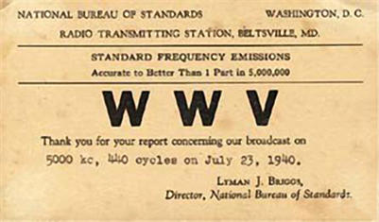
Example of a QSL CARD from 1940

Slide 5
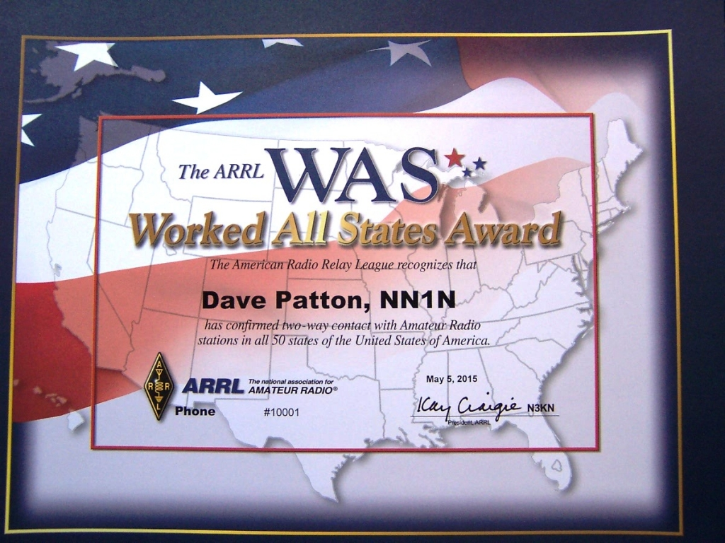
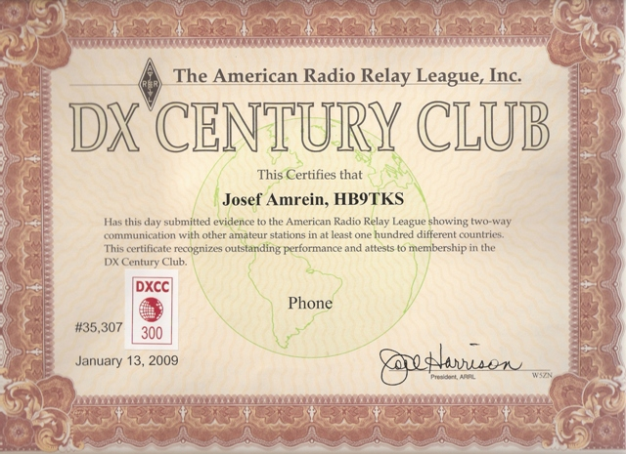
The Evolution of the QSL Card
After the ARRL was formed the ARRL thought it would be a good idea to create awards for certain achievements such as WAS and DXCC. So in 1935 the DXCC program began.
However to earn these awards the QSO had to be confirmed and that confirmation was in the form of a paper QSL card.
Notes:
See: QST, October 1935 by Clinton DeSoto

Slide 6
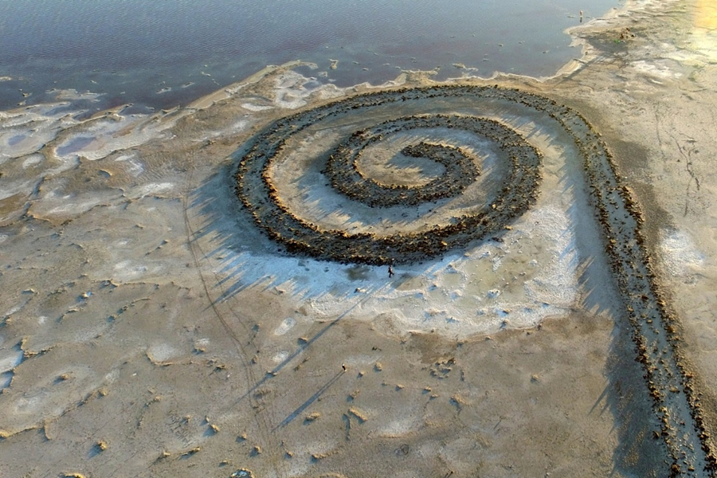
Why do we log QSO’s Today?
In the past the FCC required stations to keep a log of their contacts. This requirement was dropped in November of 1982 (see FCC-82-456)
So why do we do it today? It goes back to the idea of “confirming” a QSO. And why would you want to confirm a QSO?
  Old Habit
Just because
Award Chasing
WB7RLX
Notes:
For what ever reason the FCC dropped the logging requirement in 1982. So the question today is “Why do we log QSO’s today?” Is it just that old habits die hard? For the fun of it? I’m sure that if we did a survey among hams that still log QSO I’m sure we would find that so do it out of habit and some just because they what to keep track of who they have worked. But I believe the biggest reason is for the purpose of chasing awards. But understand for awards it more than just logging, there also has to be “confirmation” In short both participants have to log the QSO and then send confirmation. And the properties of that conversation must agree. Let’s look at this a bit closer….

Slide 7
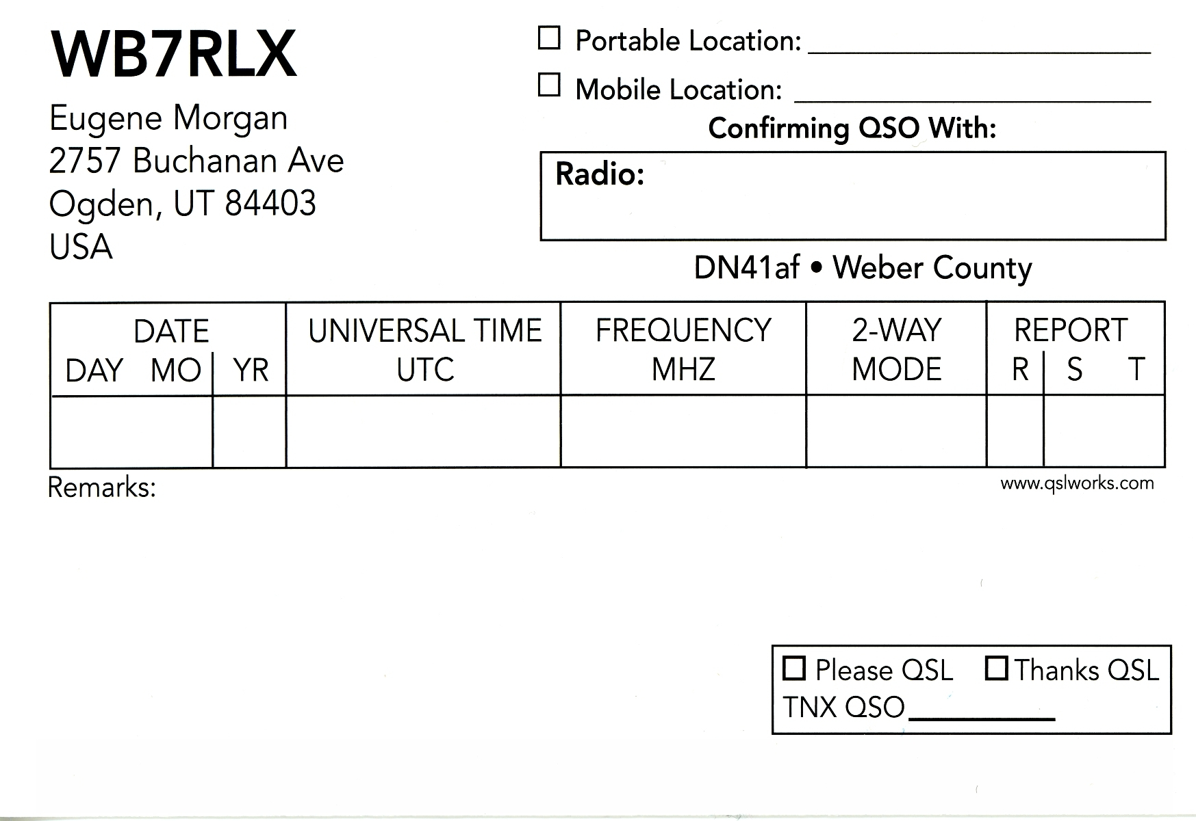
What is Confirmation?
Confirming A QSO requires the Following Information from both stations:
Call Signs - both QSO reports must name the same two call signs
Date/Time (UTC) - both QSO reports must have the same timestamp, +- 30 minutes
Band - both QSO reports report the same band in use
Mode - both QSO reports report the same mode in use

Slide 8
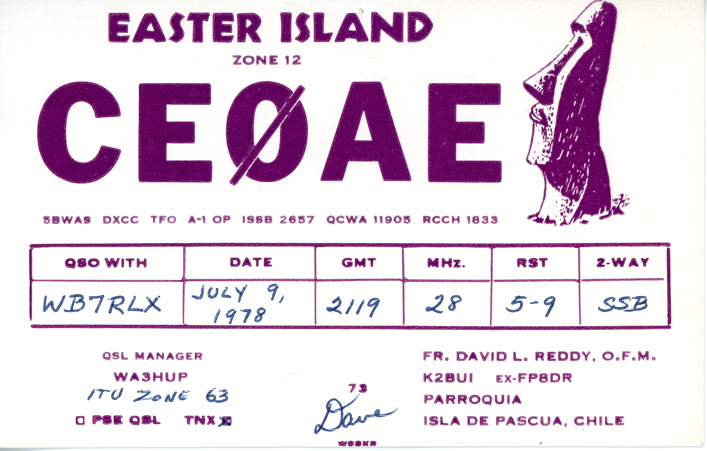

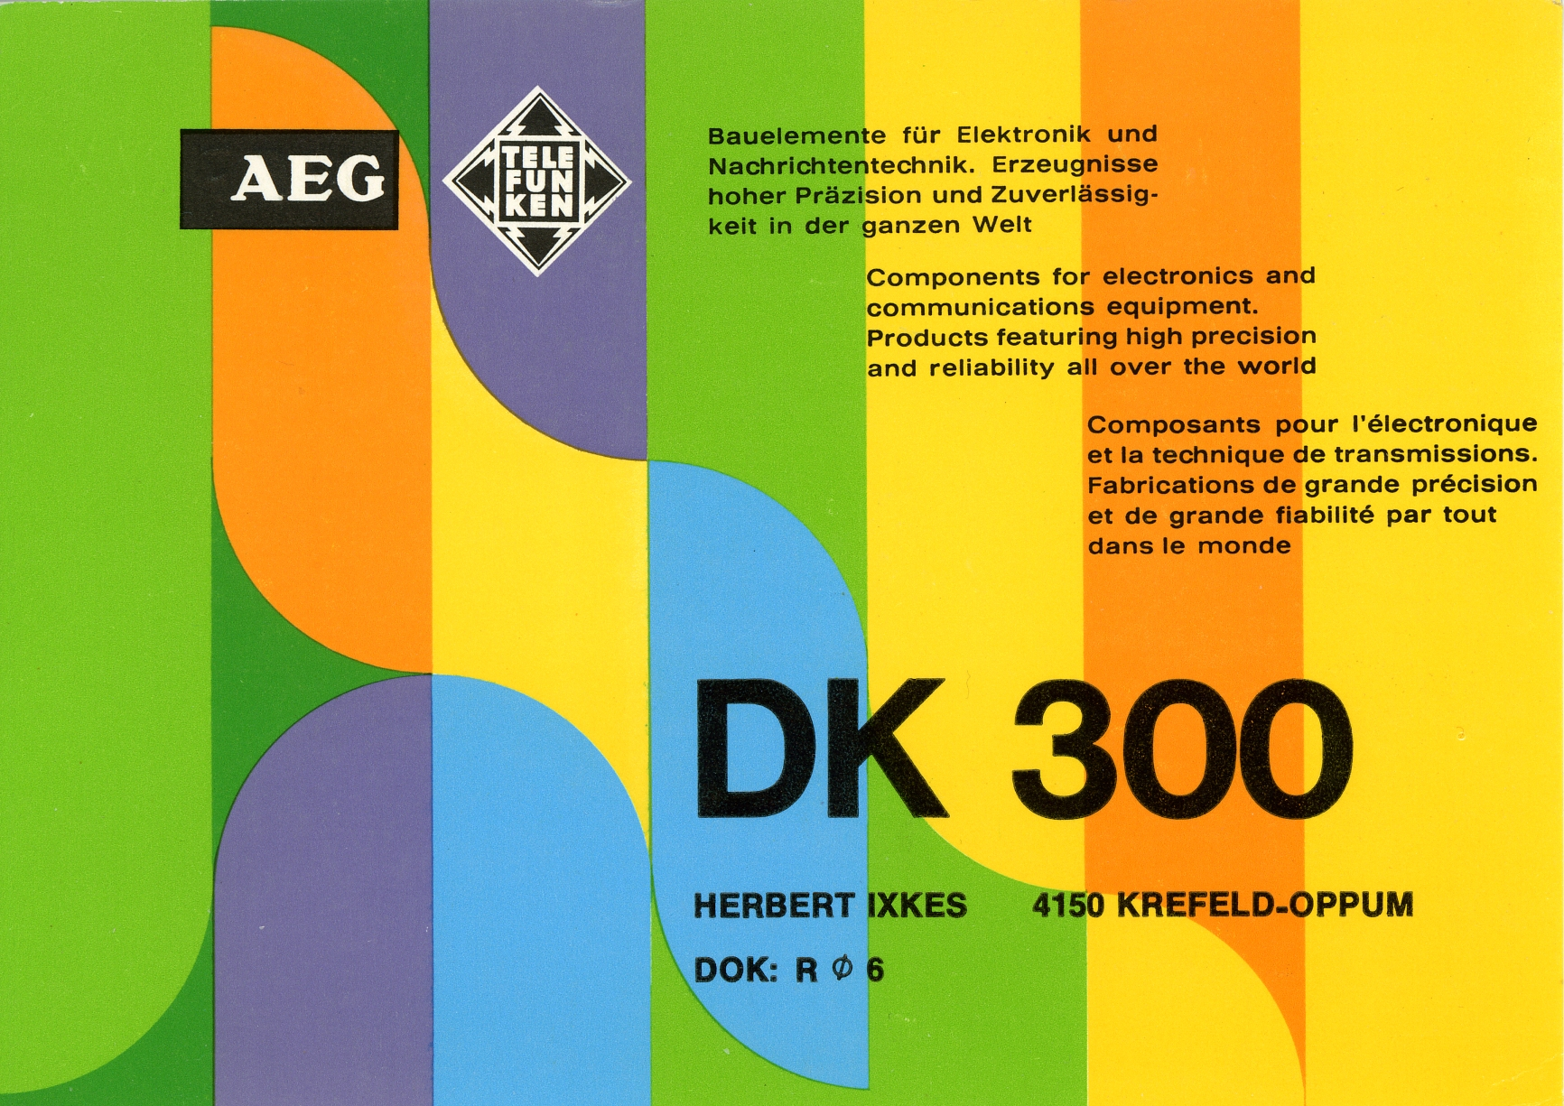



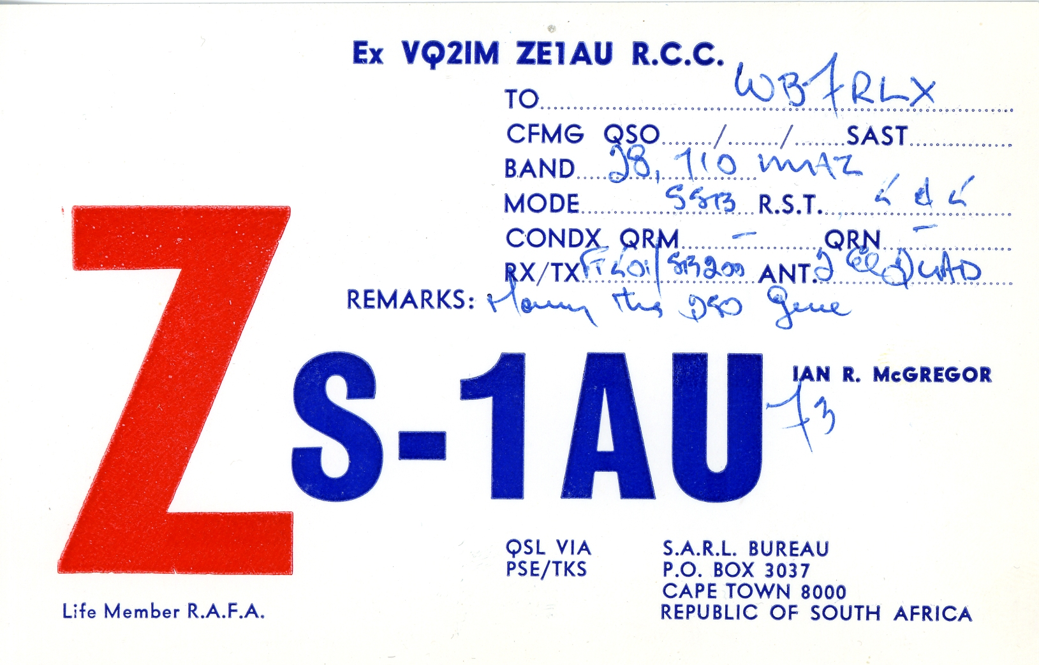
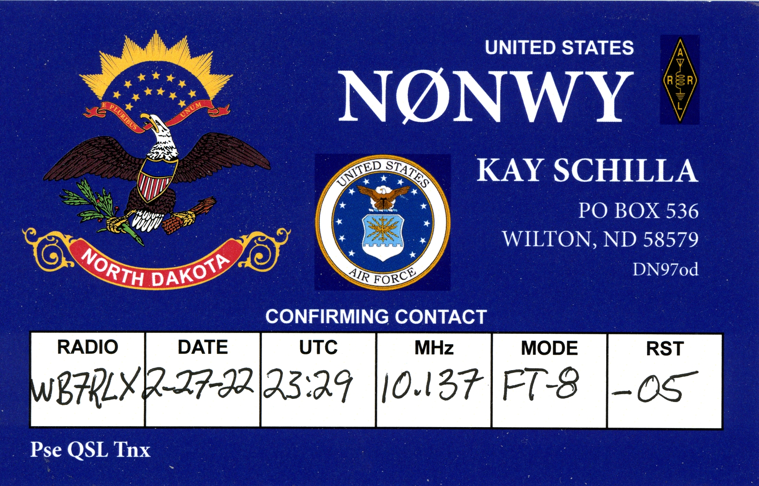
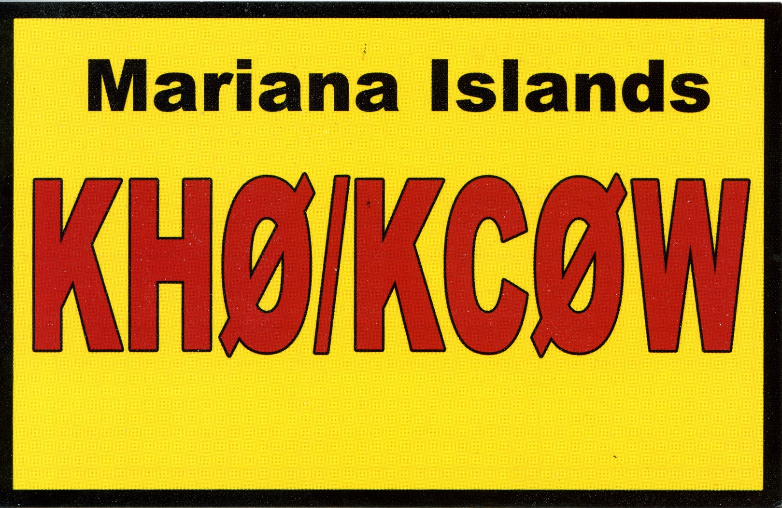


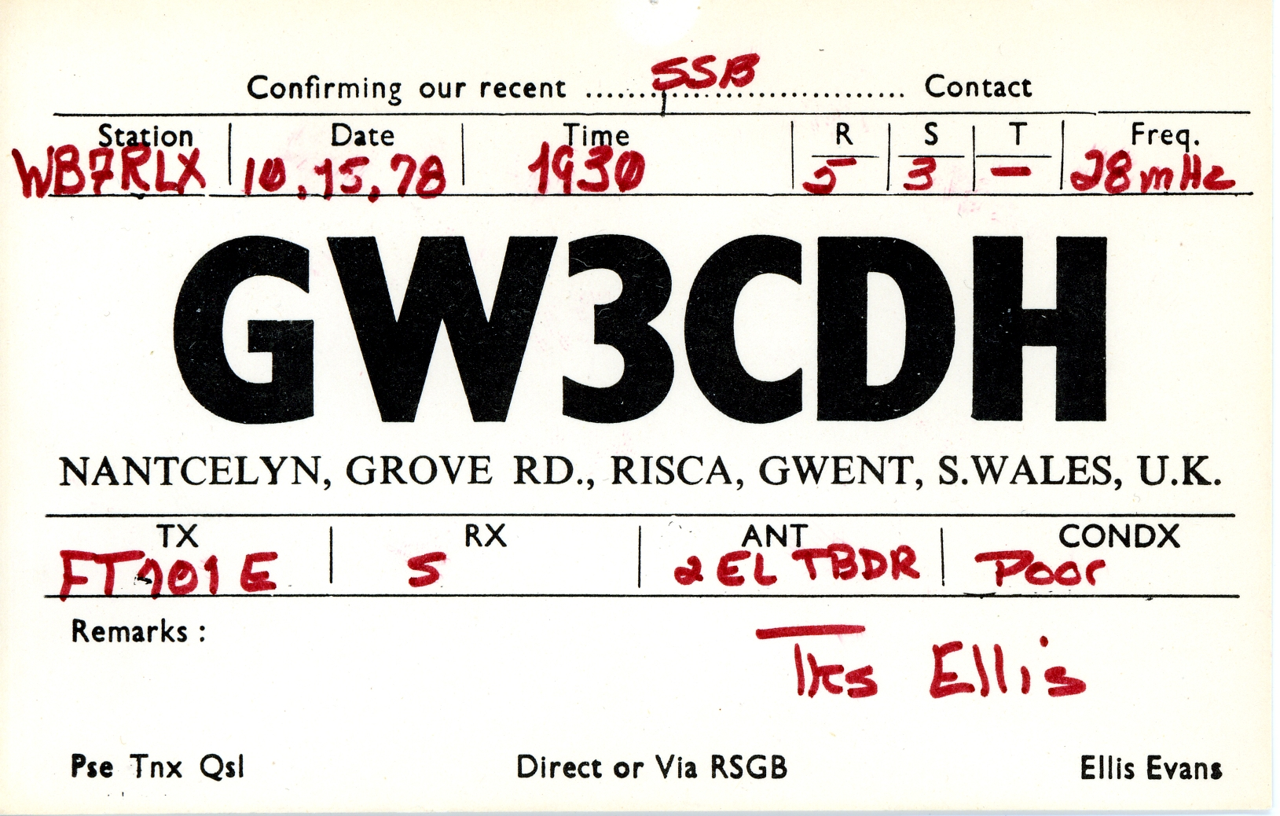
A just in case you were wondering
Yes people still send out paper QSL Cards! Although it’s not as prevalent as it once was.

Slide 9
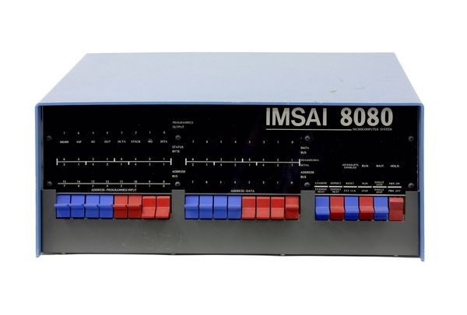
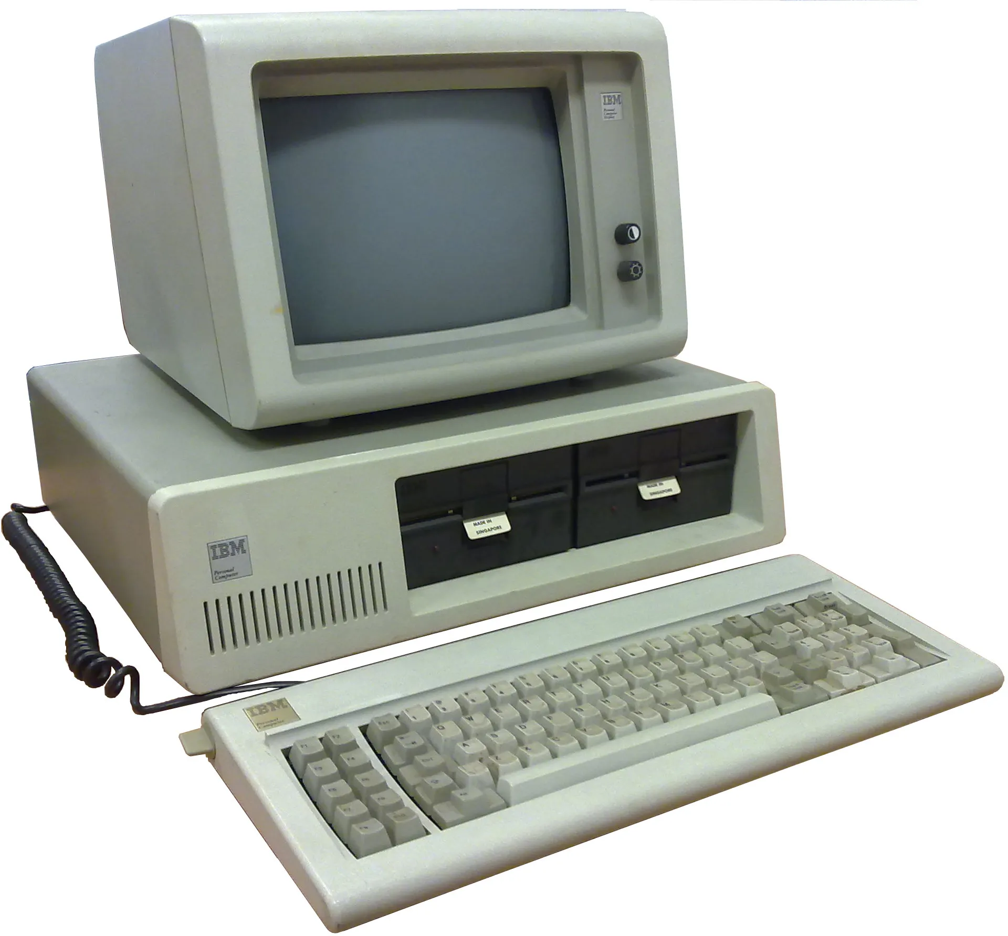
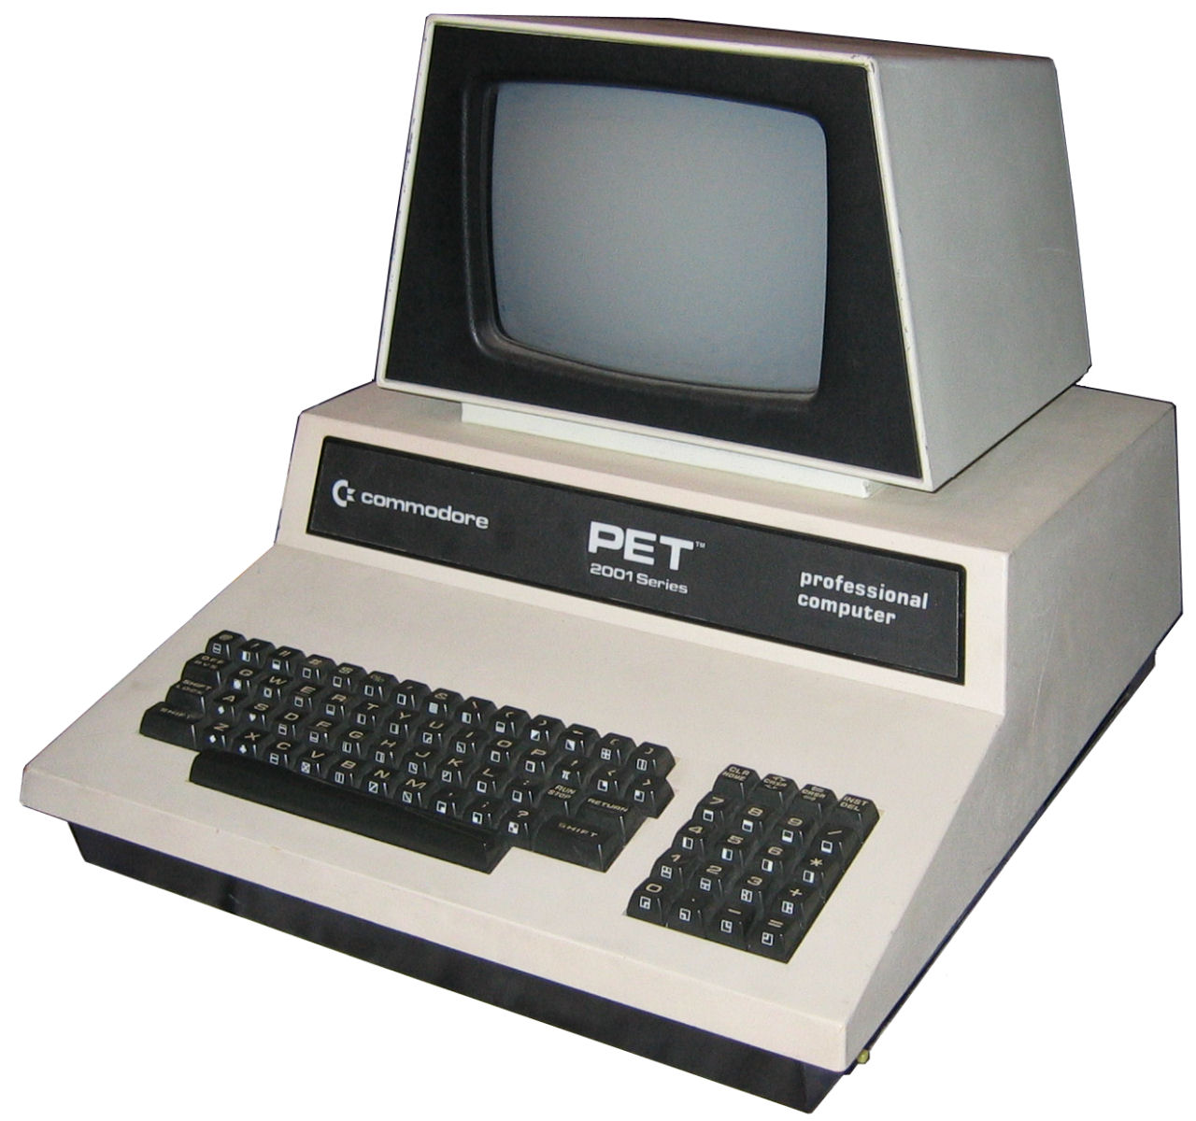
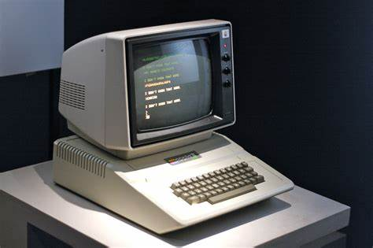
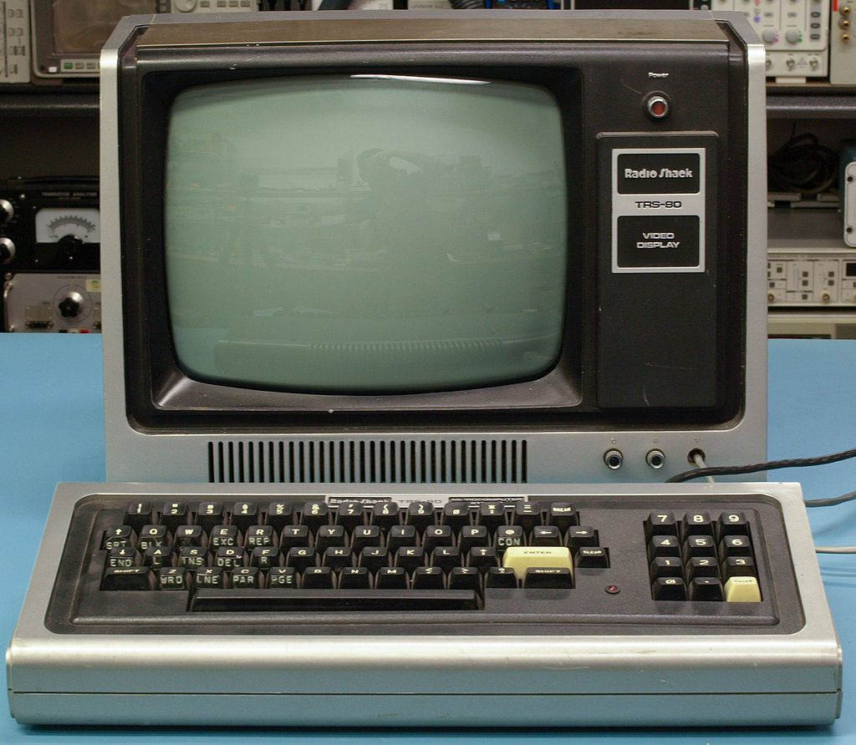
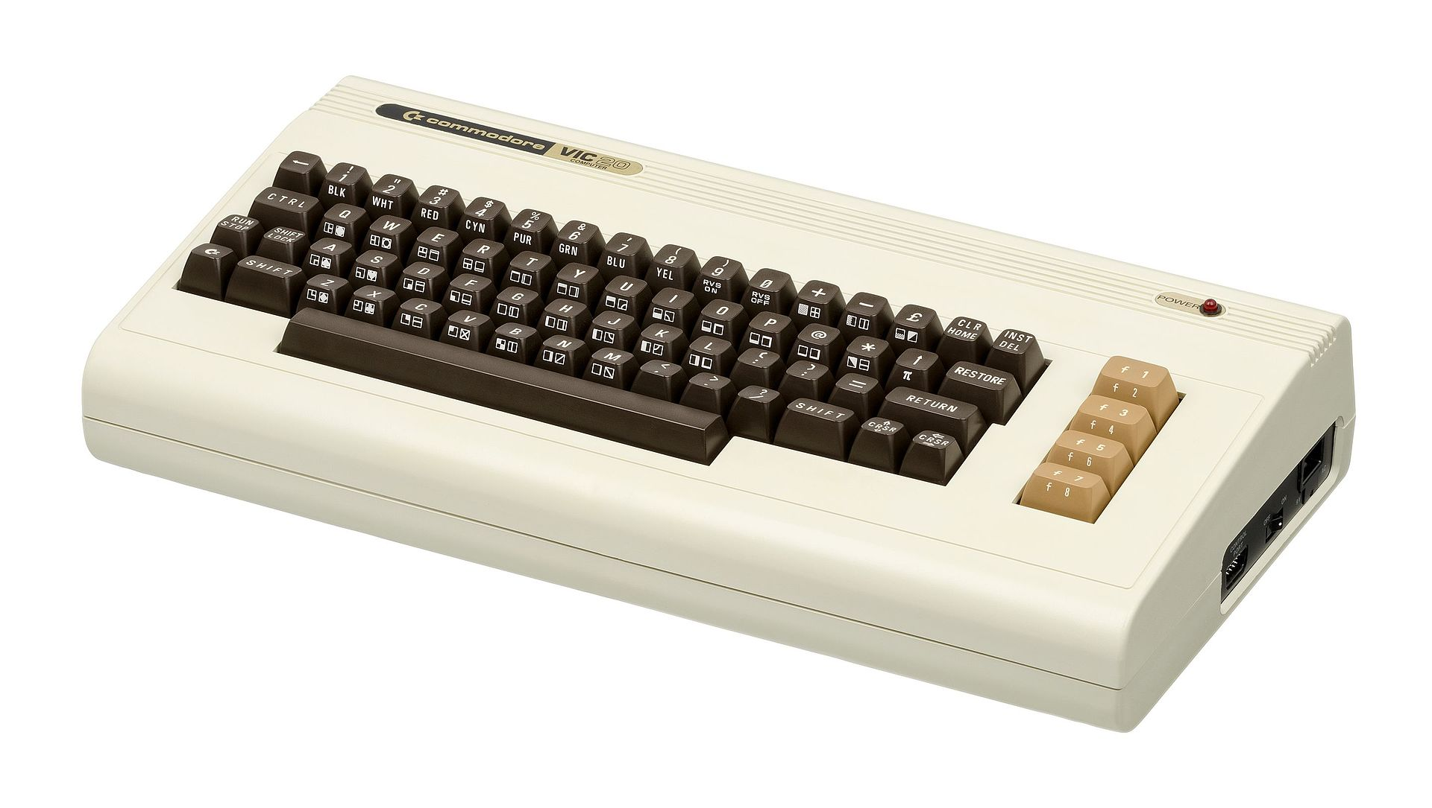
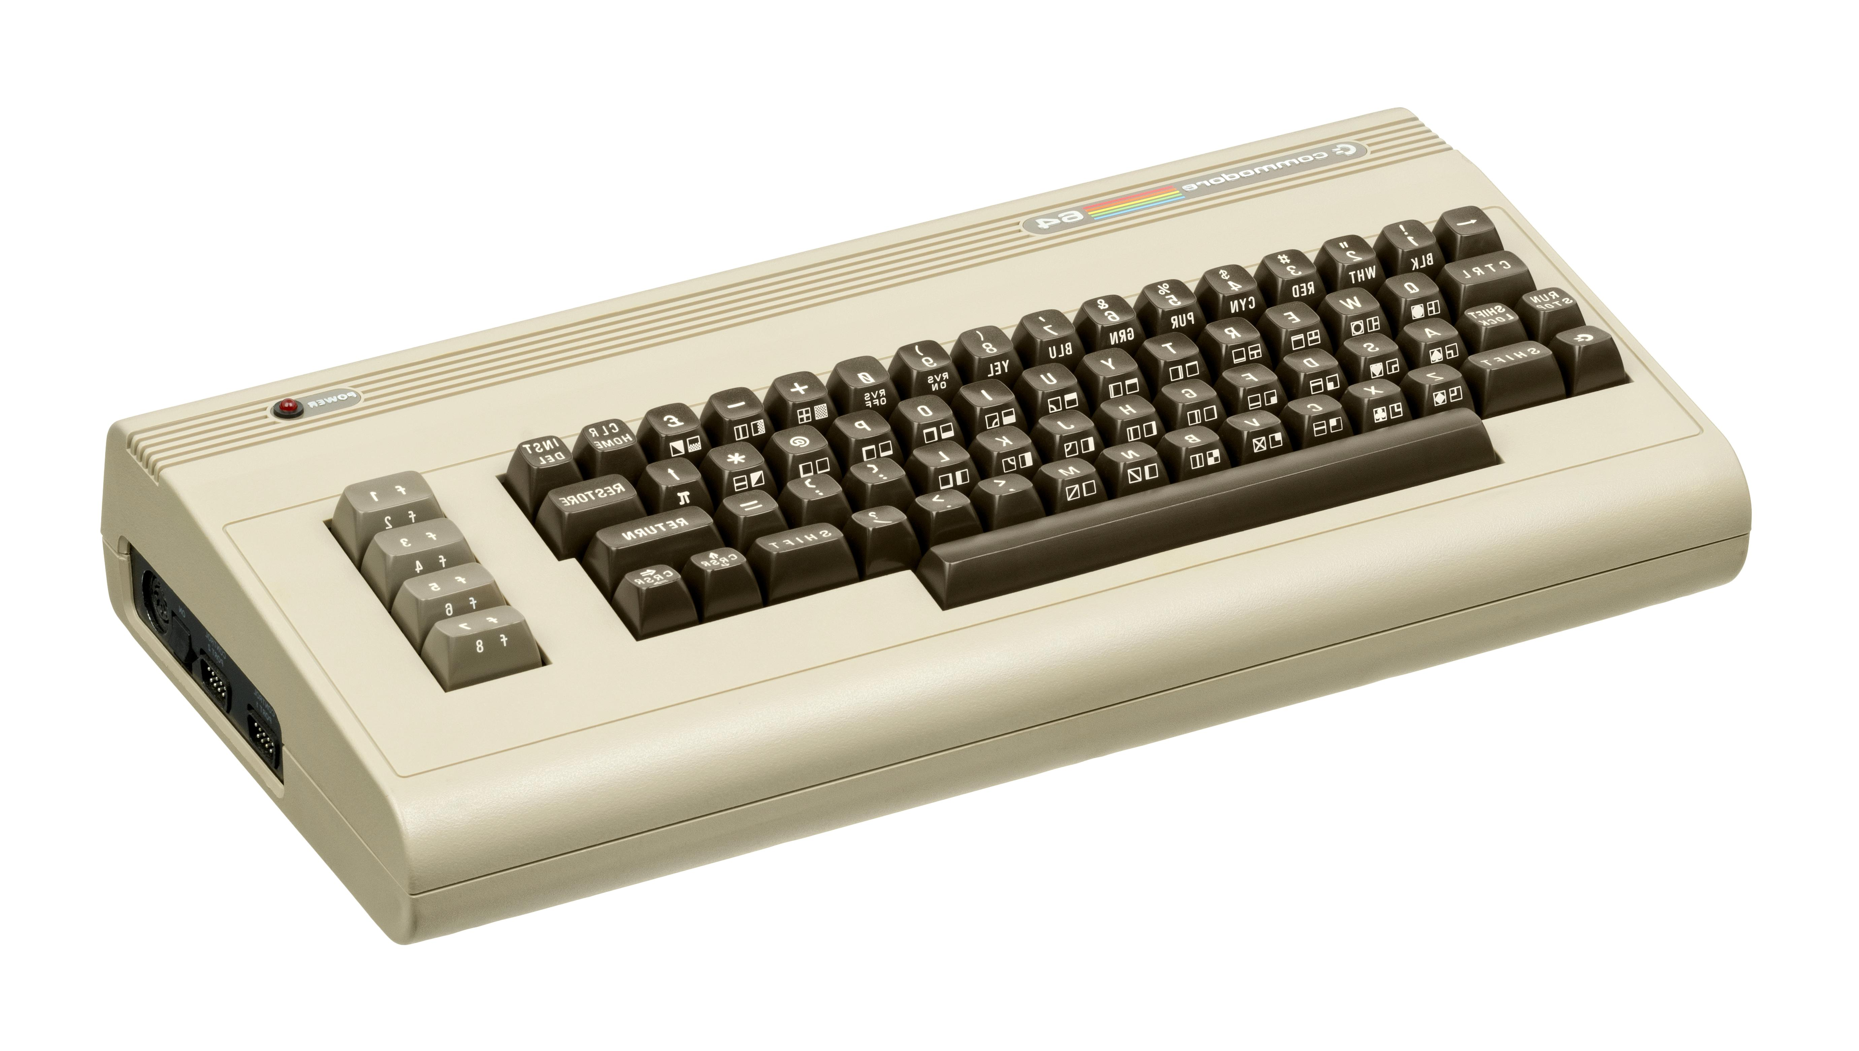
And A long came the Computer (1977)
IMSAI, 1975
IBM PC, 1975
Commodore Pet, 1977
Apple II, 1977
Commodore VIC 20, 1980
Commodore 64, 1982
TRS 80 Model I, 1977
Notes:
Needless to say the computer and Ham radio went together like Champaign and strawberries, a match made in heaven. The computer had a hundred uses in ham radio from sending and receiving RTTY to designing antennas and circuits. And one if the uses was naturally logging.

Slide 10
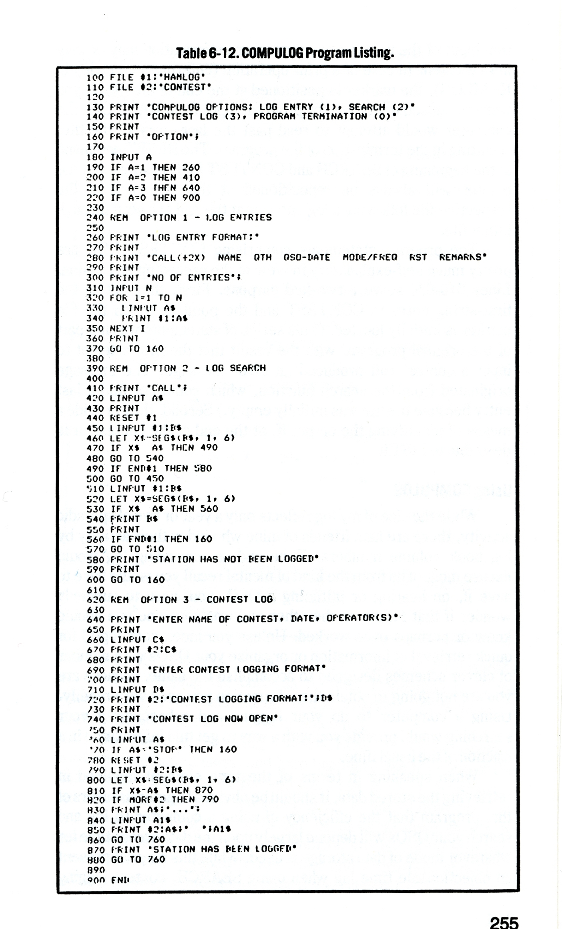
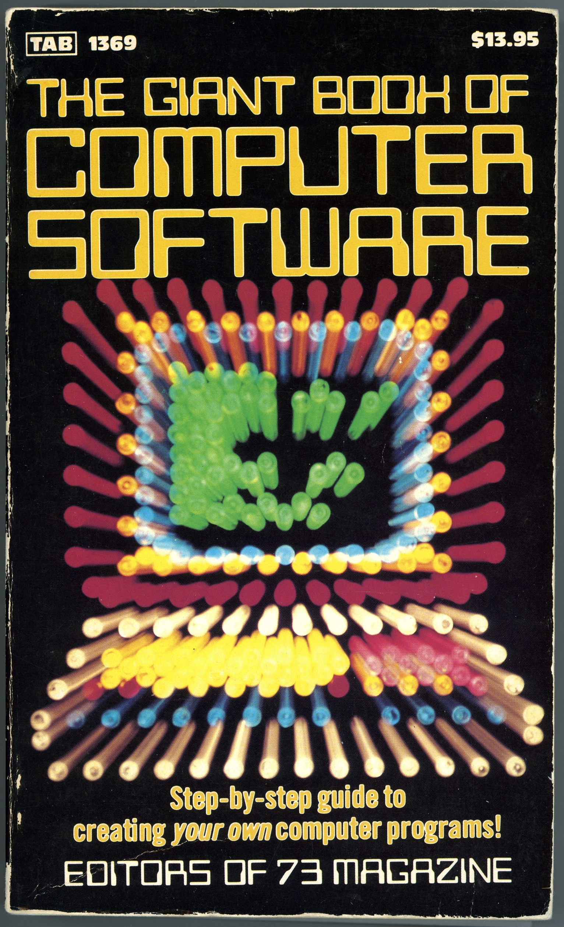
Sample Logging Program from 1981
A “Type-In” in GWBASIC, a version of Microsoft BASIC for the IBM PC. You would often see these “Type-In” programs in ham radio magazines like QST, 73 Magazine, and CQ Magazine. They were very popular with the readers.
Notes:
This program if from the book called “The Giant Book of Computer Software” published by 73 Magazine and was first published in 1981. This book is from my personal collection.

Slide 11
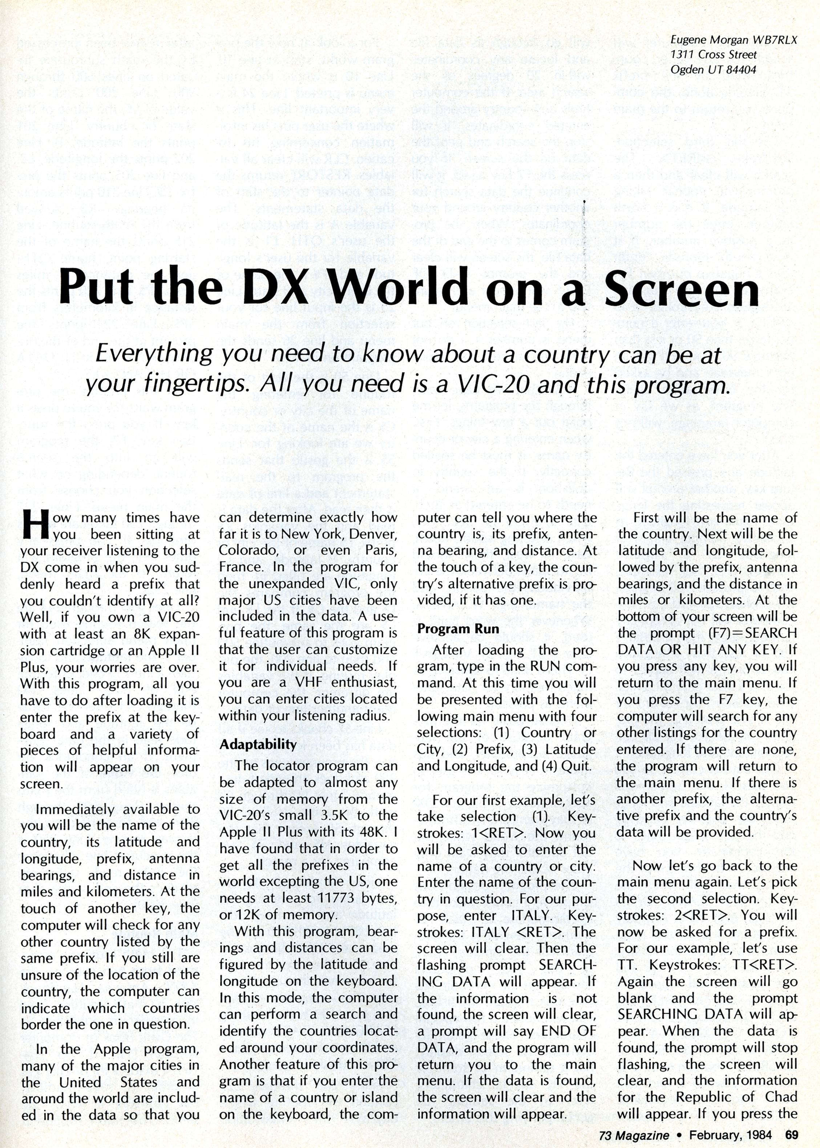
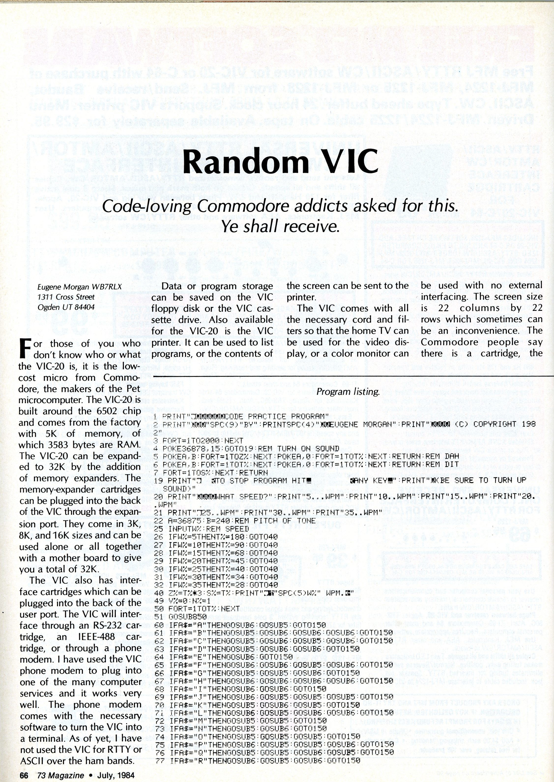
And Along Came the Computer (1977)
Even I published two programs in 73 Magazine in 1984
Notes:
These are two program I wrote for the Commodore computer back when I first got into computers. At the time I didn’t know computers would become my passion and my profession that would span 35 years. The “Put the DX World on the Screen was a program that would allow you to type in a prefix and tell you what country it was and give you’re the bearing, distance and MUF (Maximum Usable Frequency) to the country in question. The MUF portion of the program was taken from a program called minim-muf which I converted to Commodore/Microsoft BASIC. The Random VIC program was one of the very first program I wrote. I wrote it for the commodore Vic 20 which had a whopping 3.5K of free RAM and was loaded from a cassette. The Vic 20 was my very first computer…. Now let’s turn our attention to logging software in particular.

Slide 12
Logging Software
There are just too many to choose from. Here’s the list:
  https://www.eham.net/reviews/view-category?id=27
Things to look for:
  Can Import and Export ADIF files (we will get to that shortly)
  Can Upload to LoTW
  Can talk to your radio via CAT commands (Computer Aided Transceiver)
  Can access call books like QRZ, HamQTH, DX Maps, HamCall, and Callbook
Notes:
There are just too many logging programs to call out here. But the provided link should give you an idea of just what's available today. Logging programs can be broken down into two basic categories. One for contesting and one for everyday use and yes some can be adapted or extended to do both. From my perspective the most popular are: Ham Radio Deluxe, LogBook4OM, N1MM, N3FJP, and QRZ. There are many many more. Note that QRZ is an online log book while the others are installed on your local hard drive. Note that I did not include LoTW in this list. I consider LoTW a cloud based QSO database and not a logging program per sa given that it doesn’t have a user interface suitable for direct data entry of QSO information. LoTW depends on other input systems such as those mentioned above.

Slide 13
And then Along came the Internet (1969)
As the Internet began to become ubiquitous someone decided that it might make a great way of confirming QSO’s.
  It eliminated the cost of sending out paper QSL cards not to mention the cost of the QSL cards themselves.
  Mail did not work equally well worldwide
  The mail was slow and especially so in certain parts of the world.
Fun Fact: LoTW came on line in 2003.
see: Mills, Wayne (October 2003). "Introducing Logbook of The World". QST. 87 (10): 46–47.
Notes:
See: A Brief History of the Internet - Internet Society

Slide 14
What’s an ADIF: Amateur Data Interchange Format
ADIF is a publish standard for exchanging QSO information
It establishes an agreed to standard for field names that can be used in identifying specific properties of a QSO such as:
Call Sign, Signal Reports, QTH Information and so on.
See: http://www.adif.org/

Slide 15
What does an Electronic Log Look Like?
<call:6>MI0JZZ <gridsquare:4>IO65 <mode:3>FT8 <rst_sent:3>-19 <rst_rcvd:3>-12 <qso_date:8>20230214 <time_on:6>181600 <qso_date_off:8>20230214 <time_off:6>181800 <band:3>10m <freq:9>28.074553 <station_callsign:6>WB7RLX <my_gridsquare:6>DN41AF <tx_pwr:3>100 <eor>
<call:6>IS0KNG <gridsquare:4>JM49 <mode:3>FT8 <rst_sent:3>-17 <rst_rcvd:3>-17 <qso_date:8>20230214 <time_on:6>183000 <qso_date_off:8>20230214 <time_off:6>183100 <band:3>10m <freq:9>28.074664 <station_callsign:6>WB7RLX <my_gridsquare:6>DN41AF <tx_pwr:3>100 <eor>
Notes:
This is an example of my own log book as seen via Windows Notepad. Although there are several hundred records in this file this shows and excerpt of just two separate QSO’s. Note that each QSO entry is terminated with an <eor> label which indicates the end of a given record. The advantage to this format is each record can be of a different length and the fields do not need to be stored in any specific order. The only requirement is each record must use the standard labels and that the length of each field be indicated. <label:length>data <label:length>data Example 1: <call:6>WB7RLX Example 2: <call:4>W7SU
The key purpose of the ADIF format is to provide a means of transferring logbook data from one system to another such as when uploading your logbook to QRZ or LoTW. Writing parsers for ADIF files is fairly simple.
The ADIF format is dynamic and is constantly being amended to include additional labels. The current ADIF standard is version 3.1.4 (as of March 2023)

Slide 16

Notes:
Now let’s dive into Log Book of the World aka: LoTW

Slide 17
LOTW: Pros and Cons
Pros:
  It Free!
  Uses digitally sign certificates (military grade security)
  QSO’s recognized by ARRL. Makes QSO’s eligible for ARRL WAS, DXCC and other ARRL specific awards.
Cons:
  Cryptic User Interface
  Hard to Set up – due mainly to security requirements
  Takes time to set up – requires the ARRL to mail security key
  Single purpose - electronic Logging and reporting
  Requires installation of software on your local hard drive: Tqsl
Notes:
The biggest pro is that QSO’s confirmed by LoTW are recognized by the ARRL. It’s second biggest pro is it uses military grade public key/private key security system. In short that means that no one else can upload to your logbook. This also happens to be one of it’s biggest cons. Setting up this public/private key security is complicated and takes time and it requires you to configure which ever logging program you are using to use the LoTW security certificate for signing logs before being uploaded to LoTW. Also note that QRZ does recognize LoTW confirmations, but unfortunately the reverse is not true. I assume that’s due to the fact that the ARRL does not consider QRZ as “trustworthy.” (Editorial Note: There are many who consider the LoTW security overkill for a bunch of hams just exchanging QSO confirmations. It’s not like life, property, or incomes will be damaged if someone tries to cheat the system.)

Slide 18
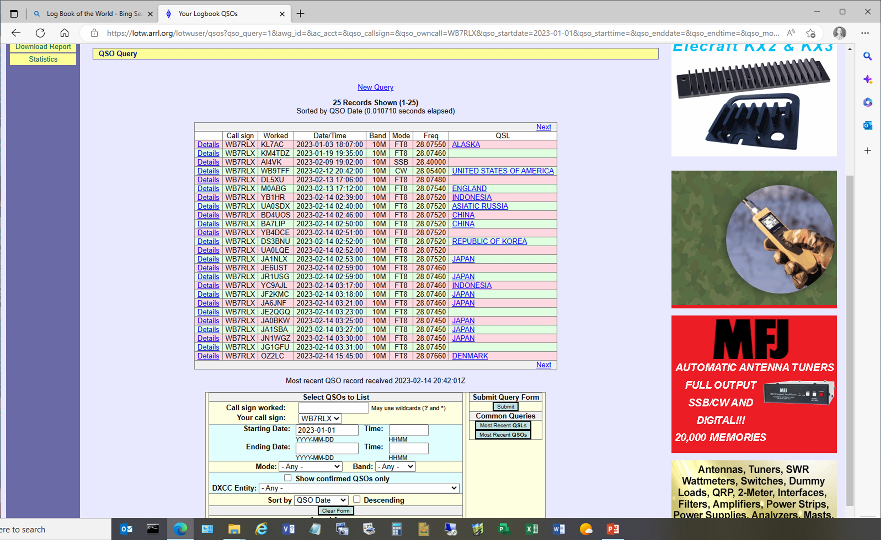
Electronic Logging: LoTW
Notes:
This is an example of the user interface. This was a query to pull up a list of my confirmed QSO’s for all of 2023. I had to enter in the search criterial before executing the search. As you can see the UI is pretty basic especially when compared to actual logging programs like LogBook4OM or QRZ. In those program all I have to do is type in a call sign and it pulls up any information in the log book and displayed it. It addition these program can also give you things like bearing and distance. This goes back to what I said earlier, LoTW is little more than a cloud based central repository for QSO’s that allow the ARRL to match up QSO’s and certify the QSO was real. Of course this allows for the QSO to count toward any one or more of the ARRL sanctioned award programs such as WAS and DXCC.

Slide 19
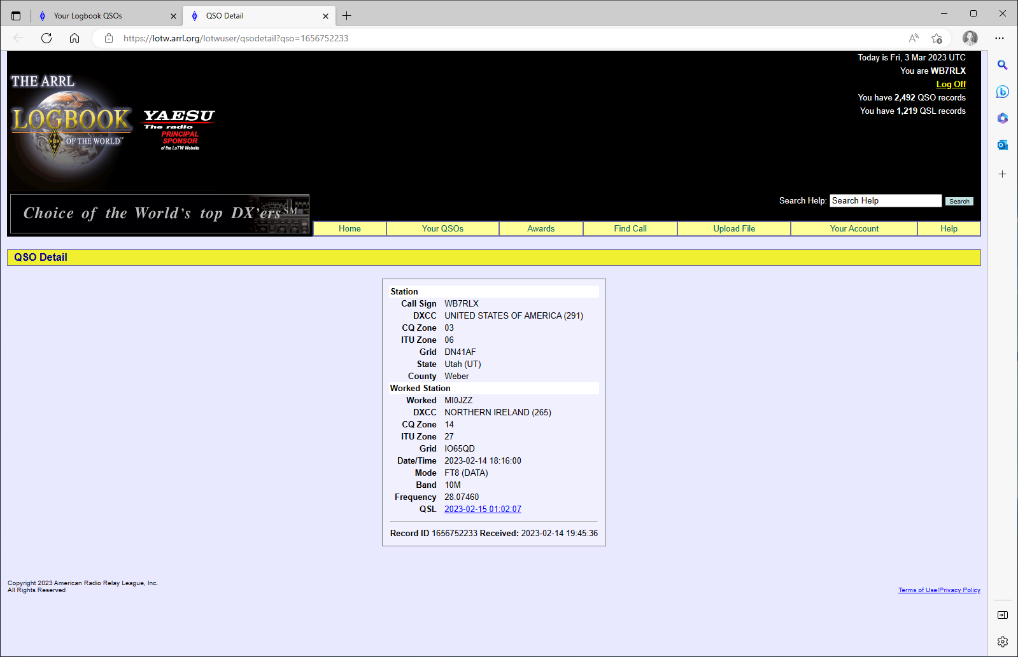
LoTW QSO Details
Notes:
This is a simple screen shot of a particular QSO. This shows how minimal LoTW user interface is. I don’t believe that LoTW was intended to be used as look book but rather just a QSO database with a minimal user interface.

Slide 20
Setting Up LoTW Logbook
Setting up an LoTW log book is fairly complicated. Far more complicated than can be explained in this meeting. But begin by going to: Getting Started — Logbook of the World (LoTW) Help Pages (arrl.org)
Also there are many very good videos on YouTube that explain the process.
A word of advise. Write down any passwords you are instructed to create and define what they are for. There will be a password for your online LoTW account and the security key for your log book. That will arrive by mail. SAVE THEM BOTH! And know the difference.
Notes:
The key point of this slide is save everything you get from the ARRL and understand the difference between your TW sign on password and your LoTW logbook password. Also, READ THE GETTING STARTED Guide It will save you a lot of frustration. It is very straight forward and provides step by step instructions.

Slide 21
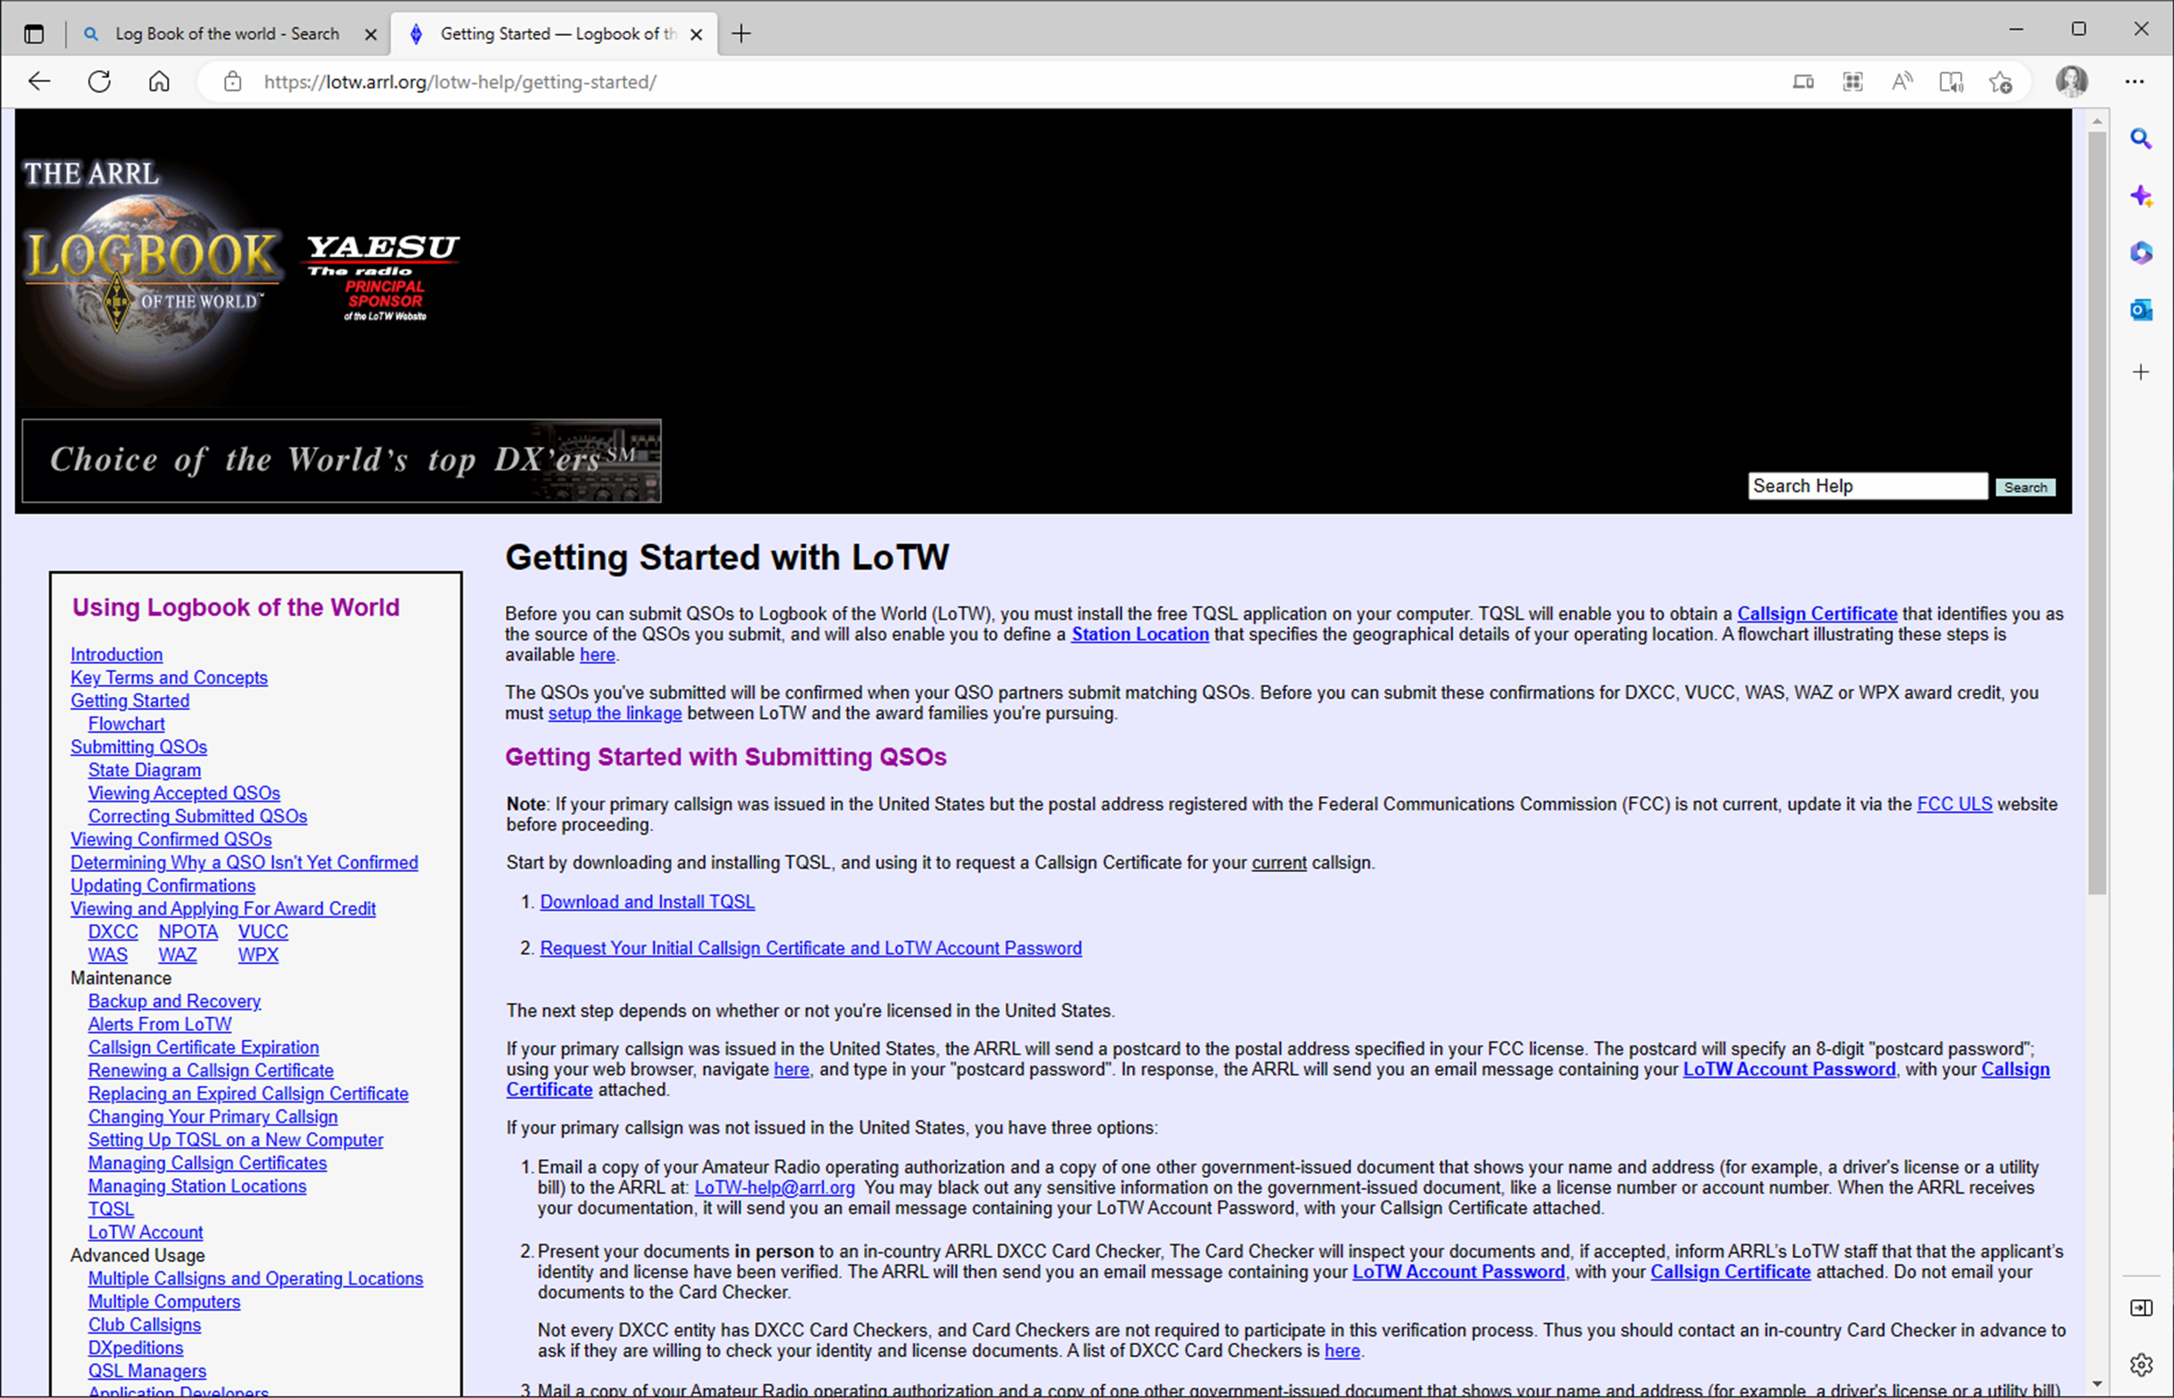
LoTW Quick Start Guide
Notes:
READ THIS Before attempting to set up your LoTW account.

Slide 22
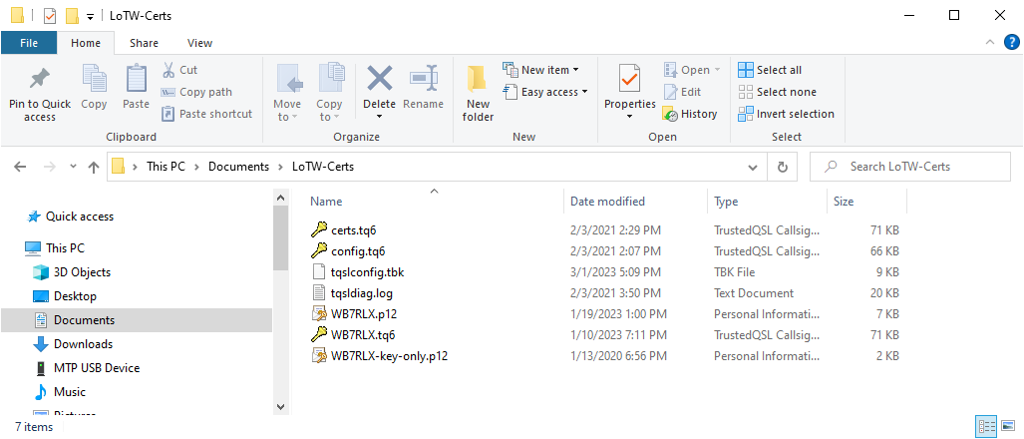
Setting Up Trusted QSL (TQSL)
When you install TQSL set up a folder in your documents directory for your LoTW certificates and other related TQSL files.
Notes:
When you setup TQSL set up a folder on your local hard drive to store all of your LoTW specific files. These files will include your certificates, certificate backups, and tqsl configuration information. In my case I set this up in my Documents folder and named it LoTW-Certs. Because this is in my Windows profile directory it can be backed up by any of the many backup utilities for Windows including Windows File History Backup. You can also copy this folder to a thumb drive and put it in your safe. Main point, know where this folder is on your hard drive and make a back up of it!. Yes you can set it up on your OneDrive but I prefer to keep it local.

Slide 23

Notes:
Now lets turn our attention to QRZ. Unlike LoTW QRZ is not only a cloud based QSO data store capable of matching up QSO’s for the purpose of confirmation but can also be used as an actual log book complete with a fairly intuitive user interface. This is what distinguishes it from LoTW. Also note that data can be imported and exported into LoTW, however as has been mentioned LoTW does not recognize QRZ confirmations. What that means is that both stations have to have uploaded the QSO data to LoTW either via QRZ or directly into LoTW. What that means is if I upload my QSO with KB7LAK to LoTW either directly to LoTW via QRZ and KB7LAK only uploads his side of the QSO to QRZ and not LoTW it will not be recognized by LoTW.
Fun Fact: What we have found is if you use both LoTW and QRZ your confirmed QSO rate will be around 80% but if you only use one or the other your confirmed QSO rate will be much lower.

Slide 24
QRZ: Pros and Cons
Pros:
  It’s easy – in my opinion far easier than setting up LoTW log book
  It has an intuitive user interface
  There is an extensive support network if you want to extend it’s usefulness
  It has a lot more to offer than just electronic logging!
  No waiting - You can have your log book up and running in minutes
  It can integrate with LoTW – It recognizes LoTW confirmations
  Many more awards and certificates available than from ARRL
Cons:
  Some features require a subscription of $35.95 year see: Subscriptions – QRZ
  Confirmations not recognized by ARRL (QSO’s don’t count toward ARRL Awards)
Notes:
The biggest advantage to QRZ is that’s it’s very easy to set up. You can set up your first log book in only a few minutes using a fairly intuitive process. The biggest con is that the ARRL does not recognize QSO’s confirmed only by QRZ. In short what that means is both sides of the QSO need to be uploaded into LoTW in order for the QSO to count toward any of the ARRL sanctioned awards. QRZ on the other hand does recognize LoTW confirmed QSO’s. What that means if the QSO is confirmed by LoTW then QRZ recognizes it and the QSO can be counted toward any of the QRZ specific awards.

Slide 25
Electronic Logging: QRZ
Light green background means the QSO has been uploaded to LoTW
Gold Star means it has been confirmed in QRZ
Green circle means it’s been confirmed by LoTW
Notes:
This is a screen print of my QRZ log book. Note the column with the gold stars and circles.

Slide 26
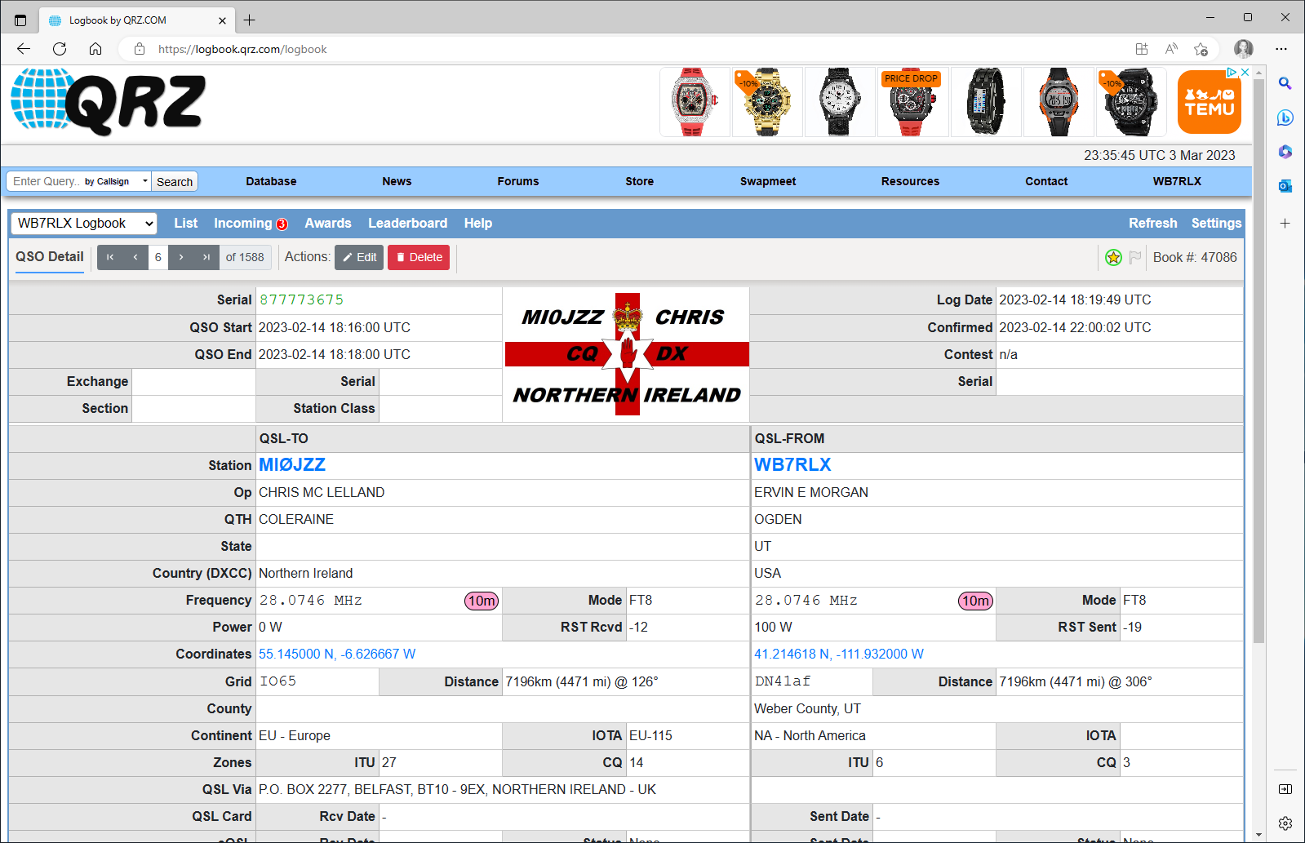
QRZ QSO Details
Notes:
This is a screen dump of my QSO with MI0JZZ There’s a lot of information here. Note that I can go to his QRZ profile page by simply clicking on his call sign. This is what I mean when I say QRZ offers a lot more functionality that LoTW and one of the biggest reasons why I like QRZ. LoTW is a cloud based database with a fairly sophisticated QSO match algorithm. QRZ is that and much more.

Slide 27
Setting Up QRZ Log Book
If you plan to import or export your log book or use a 3rd party logging program to look up calls you will need to purchase a subscription: $35.95 per year.
Notes:
However all that functionality is not free, at least not if you want to exploit it’s full functionality.

Slide 28
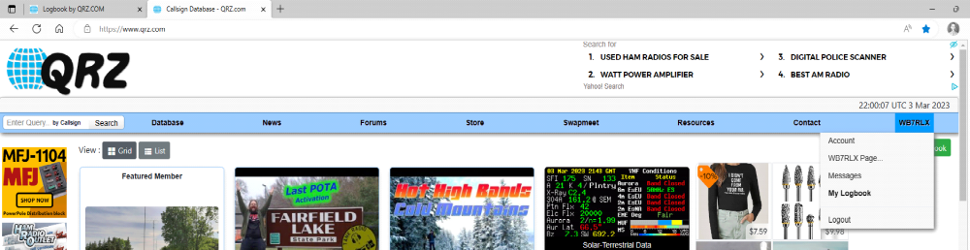
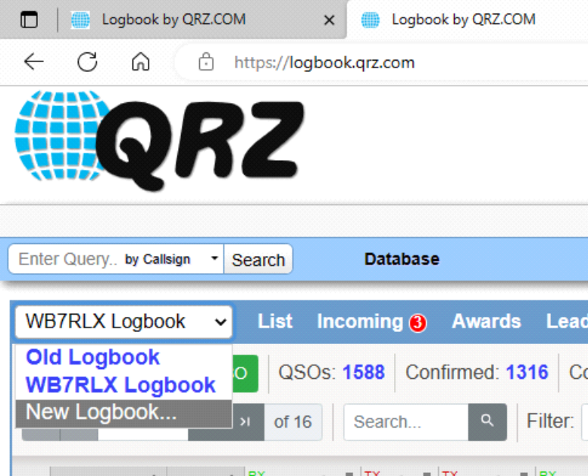
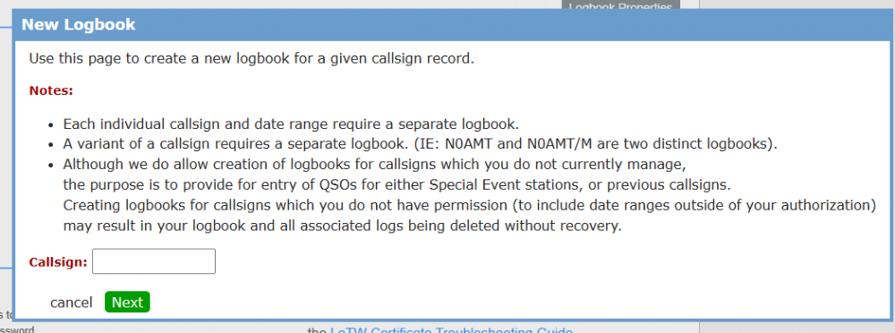
Creating a QRZ Log Book
From the QRZ Home Page Click on your call sign on the far right side of the page and then select “QRZ Logbook”
Then Select “New Log Book”
Enter in the call sign for the log book
Notes:
This slide shows you the step by step clicks for setting up you QRZ log page. However before you start the process there is certain information that you will need before you begin.

Slide 29
Creating a QRZ Log Book
After you enter in the call sign you will be asked to enter the following information: Be Prepared!
  Log Book Name
  Start Date (date of first QSO)
  End Date (date of last QSO) Suggestion: I put in my license expiration date. You can change this date later.
  Other Users
  Log QTH
  Lat, Long, and Grid (accepts a 6 digit grid)
  CQ Zone (for Utah this is 3)
  ITU Zone (for Utah this is 6)
  There are some other questions which are all optional.
Notes:
This is the minimum information you will need before proceeding to set up you QRZ log book. Let me talk specifically about the end date question. When I set up my QRZ log book I wanted to set up two logs. The first one was for my activities before I move into my current home. What I did was look up the date of my first and last QSO before I move to my current QTH. This became my Start date and end date for my first log book. I name that log book simply “Old” I then uploaded that log file which was in a ADIF format to QRZ. I never did bother to upload that log book to LoTW. Next I created my second log book and called it WB7RLX. For starting date I put the date of the first QSO I logged from this QTH. And for the end date I entered in the date my current license expires. Note that when I renewed my license I was able to very easily change the end date for my log book. It was very simple.
A suggestion regarding your lat on long for your Bio page. In the bio page if you leave the lat and long blank QRZ will default your lat and long to the center of your 4 digit grid. I would recommend that you get your actual lat and long and enter it in in your profile page and not let QRZ default it based on your 4 digit grid square.

Slide 30
Importing your Current Logbook
If you have been using an electronic log book export you log book to a ADIF file. Make sure you know where you have exported your logbook to. In the video the exported file is in the root of my documents folder.
Watch the QRZImport video
Notes:
A short comment on this slide. This is the process I used to get all of my old calls into QRZ. I used LogBook4OM and hand enter in the information for all of my old QSL cards. This process took me days spread over a period of about 3 months. Once I did that I exported the log file to a ADIF file and uploaded that file to QRZ. It was interesting to see that a small number of those QSO were confirmed even though that dated clear back to June of 1977. There were even a few that were confirmed in LoTW.

Slide 31

QRZ Import
Notes:
This video goes through the process of importing an ADIF file into QRZ. One of your questions will be, where did the ADIF file I uploaded to QRZ come from? In my case it was a file created by one of my programs. In this particular case it looks at my FT8 log and pulls out the new log entries and write them to an ADIF file that I can then export into QRZ. In your case the export file could be one generated by your logging program or one of the programs you might be using, such as WSJT-X, CWTY, or MRP40. Understand that with most logging programs this process can be automatically done inside your logging program. I know Ham Radio Deluxe and LogBook4OM both have this capability. In a minute I’ll demonstrate how to import your WSJT-X/FT8 log file into QRZ.

Slide 32
QRZ LogBook Export
Notes:
This video goes through the process of exporting your QRZ log book to your local hard drive. Why would you want to do this you might wonder. If your setting up a new logging program you might want to import your cloud based log book to your client based log book. Or maybe for backup purposes. Or may you want to write a custom utility that uses your log book. It should be noted that you can also do this with LoTW, it’s just a different process.
If your are applying for one of the clubs awards such as 10 on 10 or 10 meter WAS you will need to export your log file. Once you have exported it you will receive an email from QRZ with a link to where you can download your exported log from. Just forward that email to me and I can take care of it from there. Please note your do not need to filter your log. I have written software that will do that for me and pull out all your 10 meter confirmed QSO and process that accordingly.
For LoTW you will need to send me your actual log file. If your log file is over 25MB you will need to either zip it or filter it. Most email systems limit attachment size to 25 MB but some email providers may vary.

Slide 33
Importing FT8 Log to QRZ
My FT8 Log is in: C:\users\eemorgan.000\AppData\Local\WSJT-X\wsjtx_log.adi
It will most likely in the same place but instead of eemorgan.000 it will be your login name:
C:\users\[your login name]\AppData\Local\WSJT-X\wsjtx_log.adi
Notes:
This video goes through the process of importing my FT8 log into QRZ. Note that I wrote a small utility that can pull out new QSO’s and write them to a separate file that can be uploaded to QRZ or LoTW. I will be happy to make this available to via the clubs web site. It’s small enough that I could also email it to you.

Slide 34
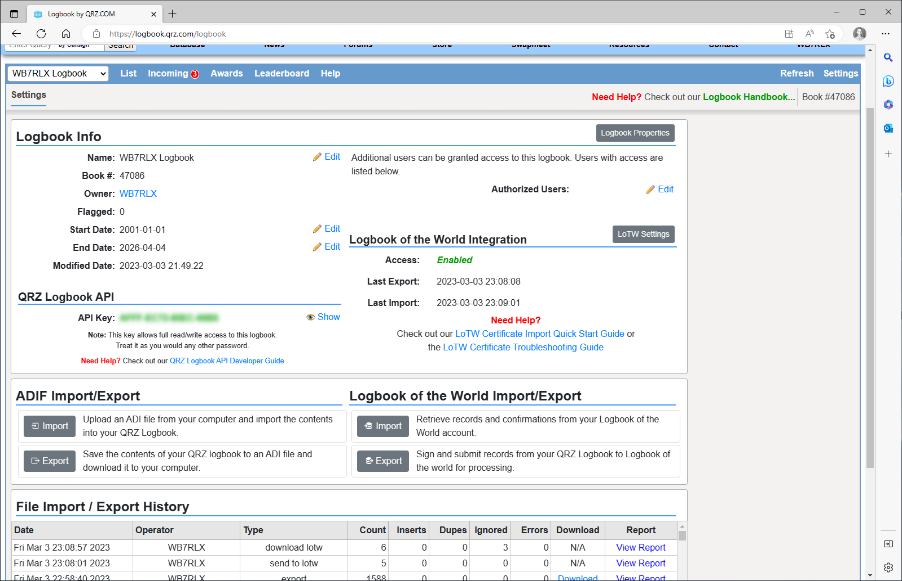
Setting up LOTW in QRZ
Read the Quick Start Guide!
Notes:
Setting up QRZ to be able to upload to LoTW is fairly straight forward. I strongly suggest you read the quick start guide. Once you have configure QRZ to upload to LoTW the process of uploading to LoTW pretty simple. From your log book page select the QSO’s you want uploaded, then click on “Action” and then click on “Send to LoTW”. The next slide shows that process.

Slide 35
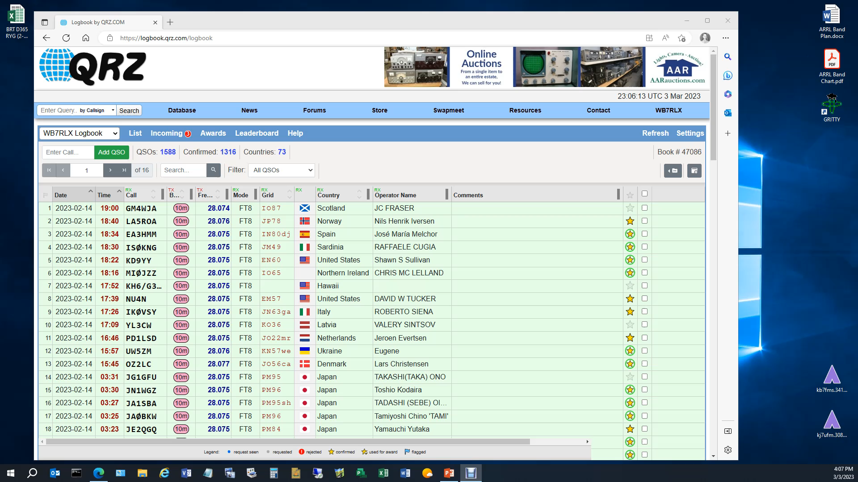
Uploading QRZ Logbook Entries to LoTW
Notes:
Step 1: Select the QSO’s you want to upload to LoTW
Step 2: Click on “Action”
Step 3: Click on “Send to LoTW”
Your done. I usually do this after every operating session.

Slide 36
Importing from LOTW to QRZ
Notes:
This video shows how to update your QRZ logbook from LoTW. I usually do this before every operating session. But to be honest you don’t have to do it that often. But you should sync them up once it a while especially if your are actively chasing awards.
Step 1: From your look book click on setting
Step 2: Click on “Import”
Step 3: Enter in your LoTW account login password
Step 4: Make sure that “Import new and/or updated records” is enabled
Step 5: Click on “Import from LoTW
Step 6: Select “Close Window”

Slide 37
Questions?
Notes:
This brings us to the end of the presentation. It‘s your turn to ask questions.

